Slide 1
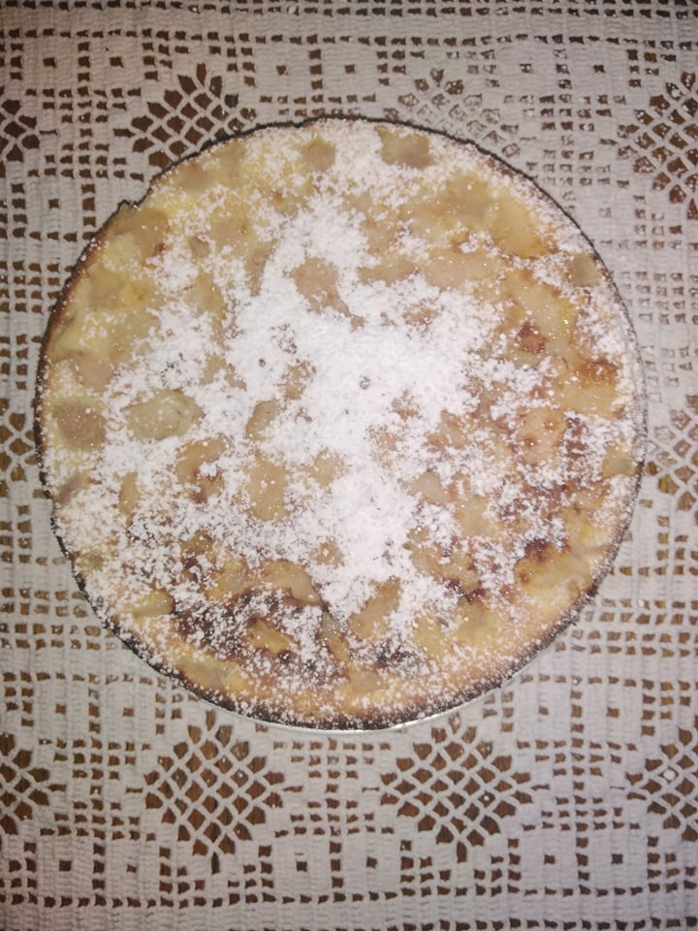
,Apple Pie‘
Made by Monika Kučinskaitė

Slide 2
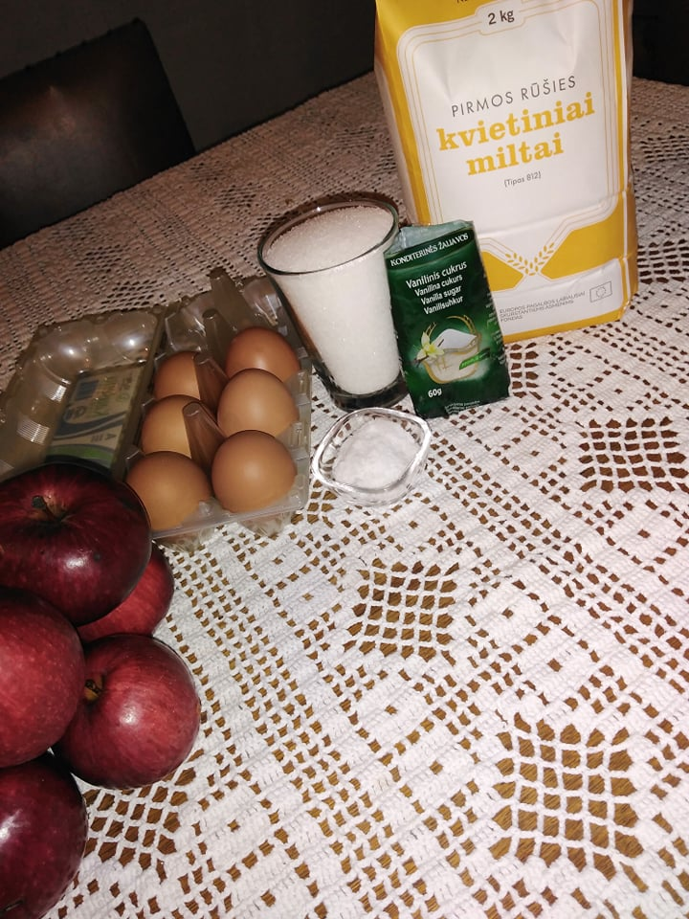
Ingredients
6 eggs
5 apples
1 glass of sugar
1 pinch of salt
1 t.s of vanilla sugar
1 and half glasses of flour

Slide 3
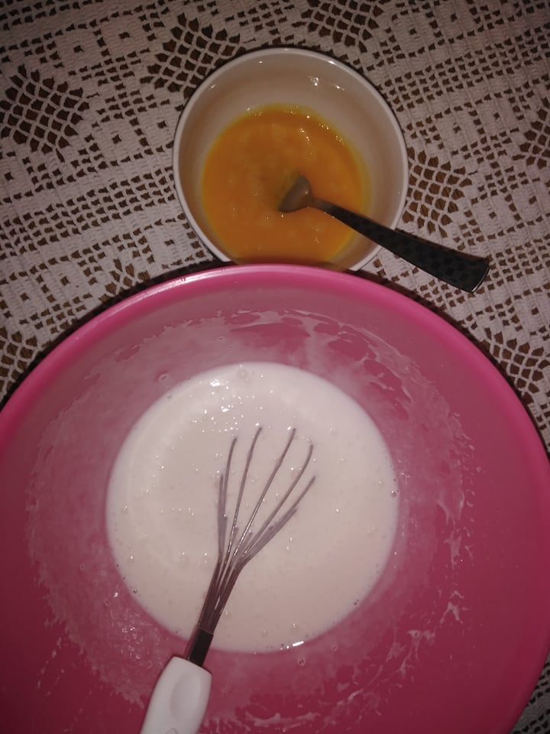
Cooking process
Separate all egg whites from the yolk, add the sugar to the whites and mix it.
Mix the yolks with a pinch of salt and pour the dough of whites and add flour.

Slide 4
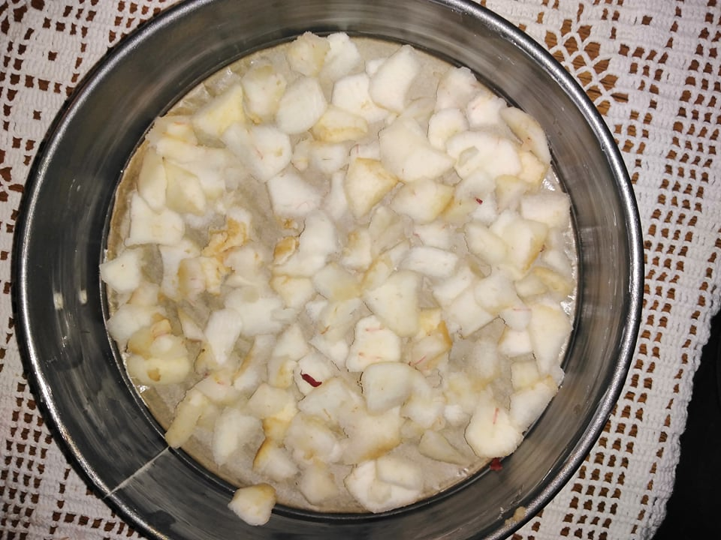
Spread out the pan with a baking paper and grease the butter, add the peeled and sliced ​​apples.

Slide 5
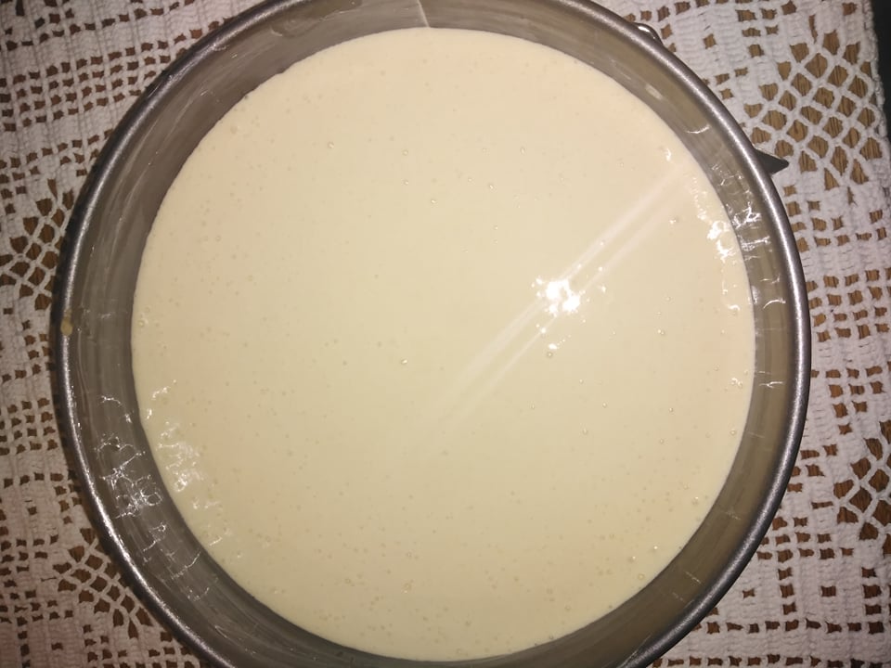
Pour the dough into the baking pan (with apples) and bake it for 35 minutes in 200ᵒc

Slide 6
Enjoy your meal!

