Slide 1
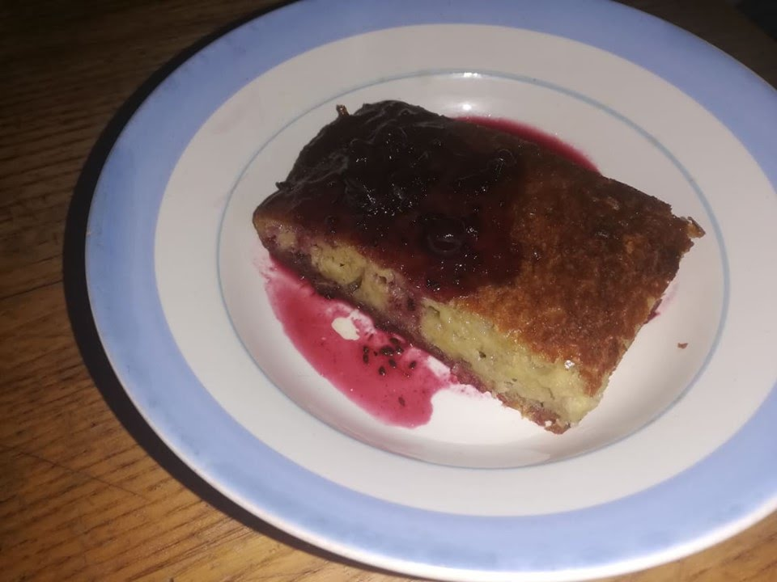
Banana Pie
Made by Erika Valantavičiutė

Slide 2
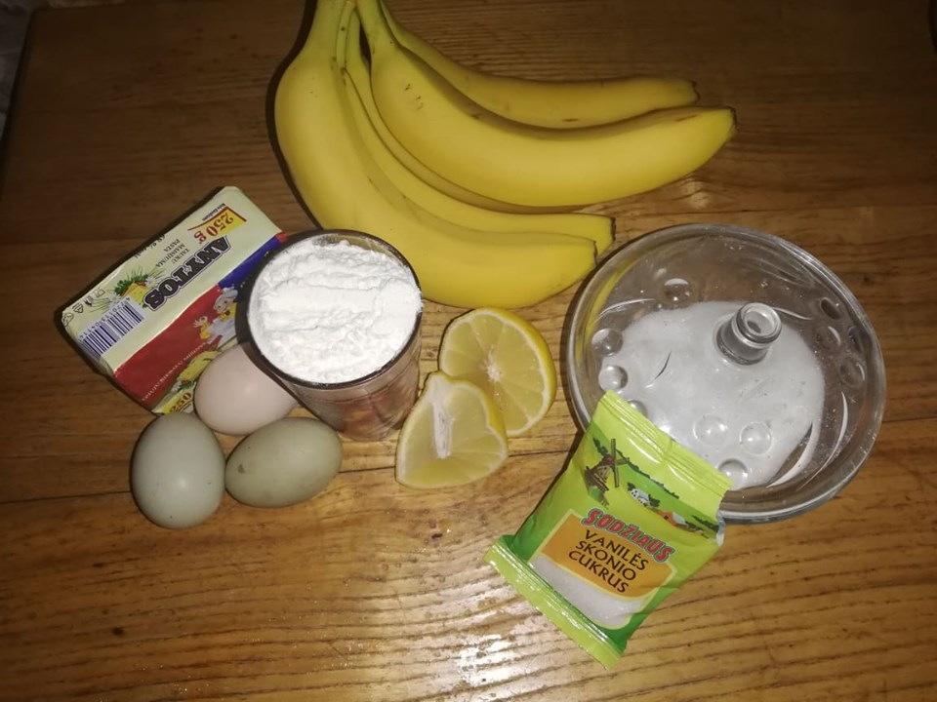
Ingredients
250g flour
200g of soft butter
80g sugar
3 eggs
3 banana
2ts. lemon juice
2ts. baking powder

Slide 3
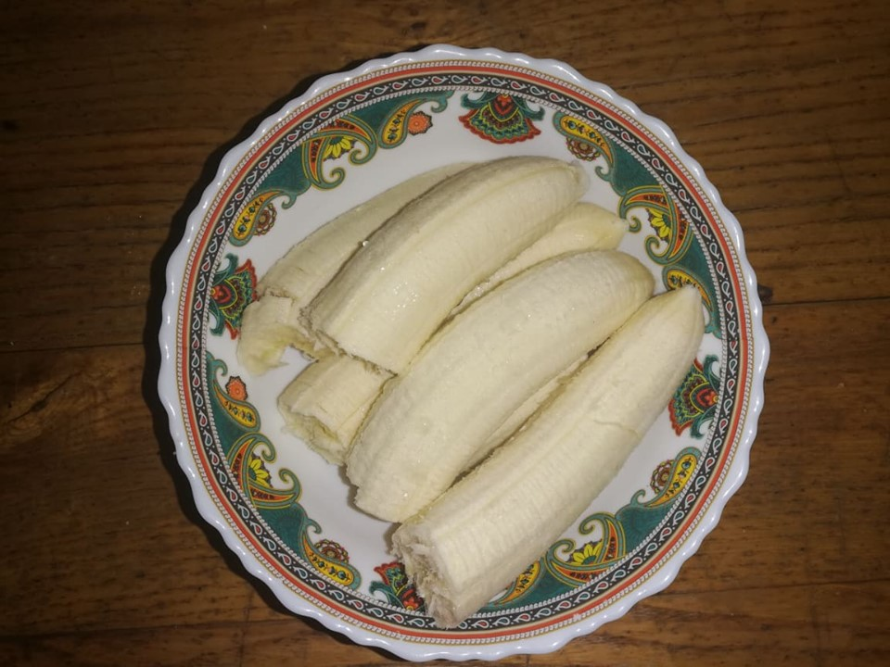
Making process
1. First peel the bananas and sprinkle them with lemon juice.

Slide 4
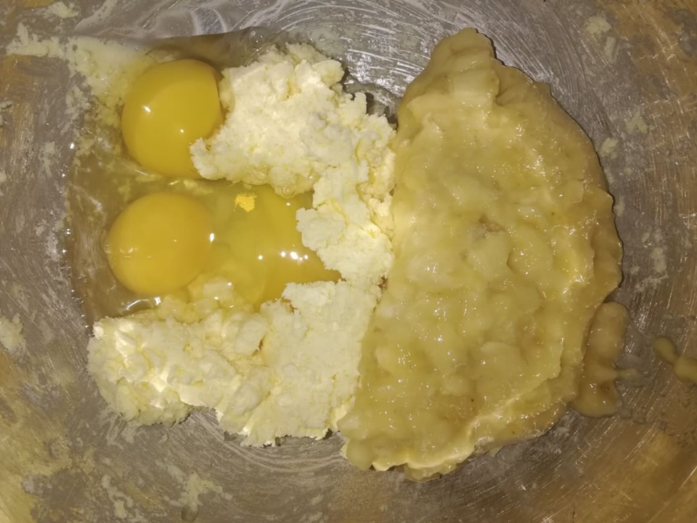
2. Wipe out the sugar with the butter in a whole dough and stir them with mixed bananas.

Slide 5
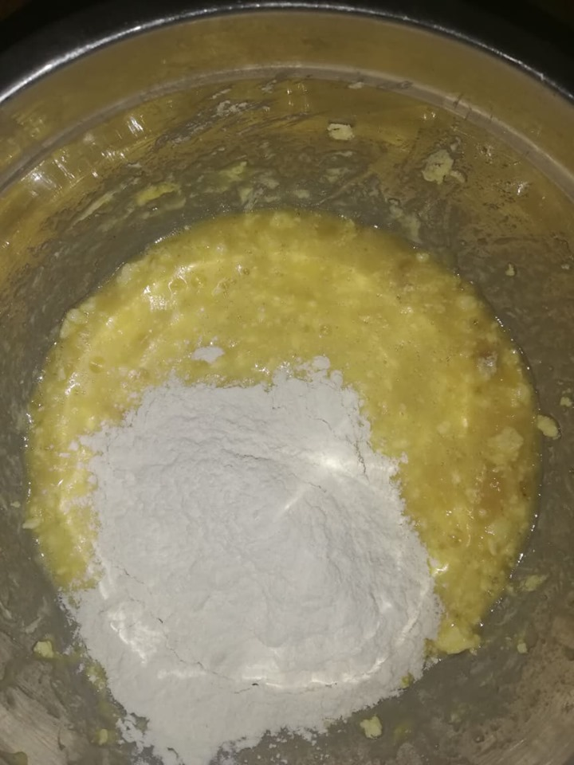
In that dough pour flour, baking powder and vanilla sugar, mix well ( avoid lumps).

Slide 6
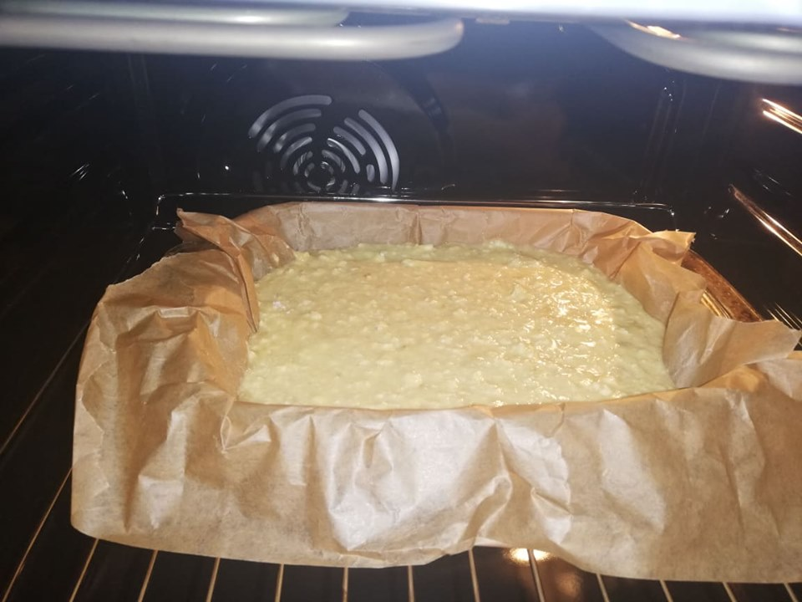
Baking process
Put the baking paper into the pan and pour the dough.
Heat the oven to 180 degrees and bake for about 30minutes. You can eat with jam or ice-cream.

Slide 7
Delicious!

