Slide 1
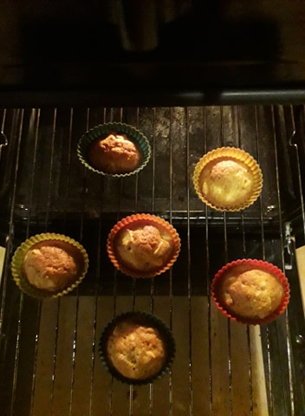
Cupcakes Made by: Kamilė Petkevičiūtė

Slide 2
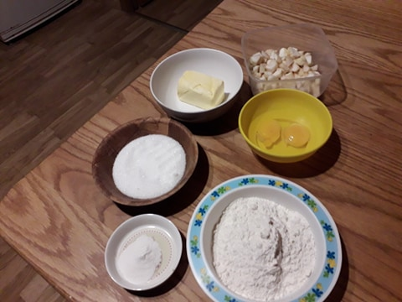
Ingredients:
150g flour
150g butter
10g baking powder
2 eggs
3-4 apples

Slide 3
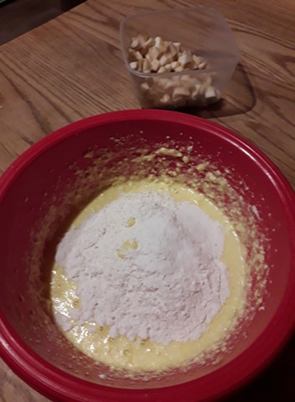
Cooking process;
Cooled butter mixed with sugar.
At the time beat one egg , baking power and flour and stir into whole dough.

Slide 4
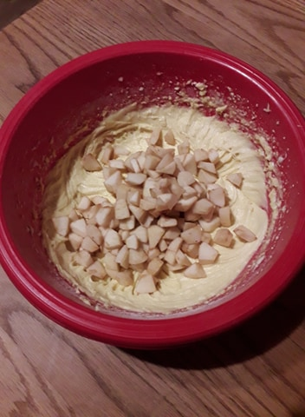
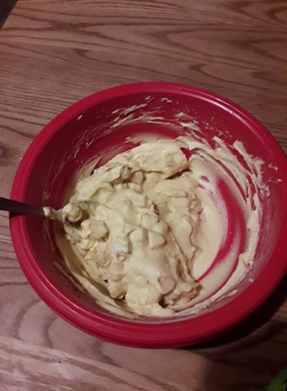
Into the dough put sliced ​​apples and stir everything

Slide 5
Bake in the oven 180 degrees for about 25minutes

