Slide 1
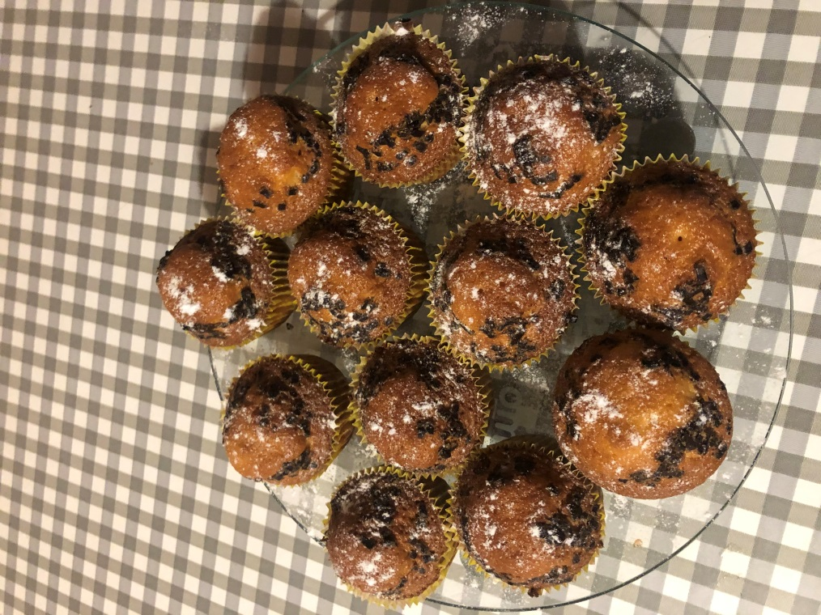
‘Cupcakes‘
Made by Vakaris Perednis

Slide 2
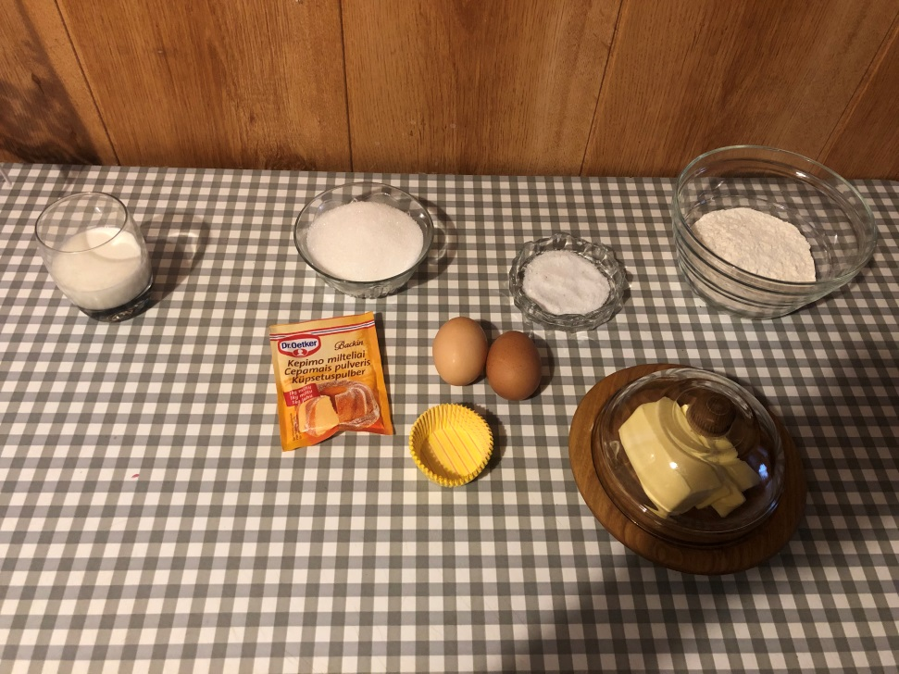
Ingrediants
170 g of sugar
120 g of flour
110 g of melted butter
100 ml of milk
2 eggs
1 ts baking powder
1 pinch of salt

Slide 3
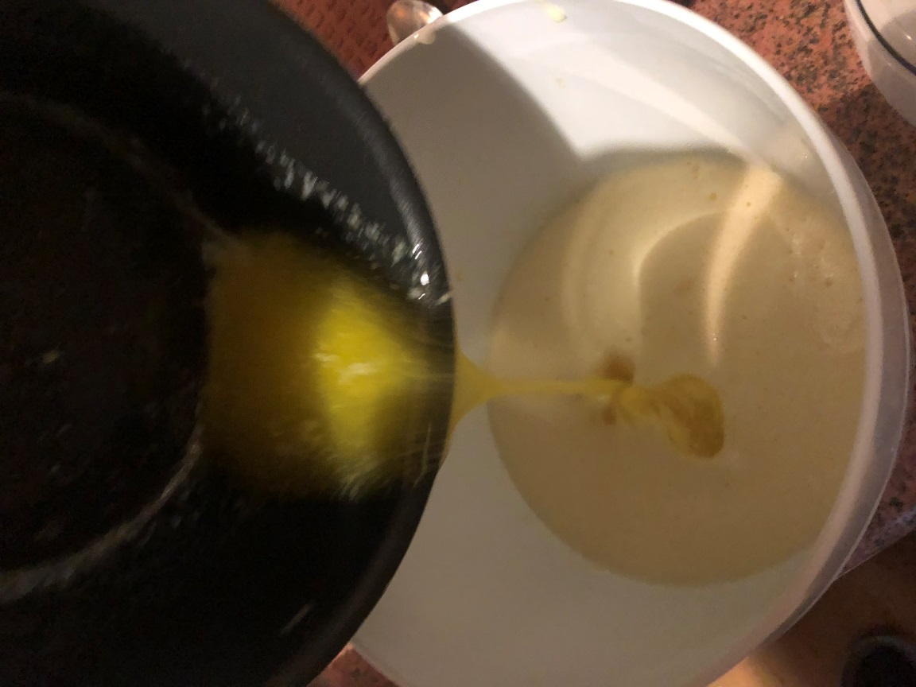
Making process
Beat eggs into the bowl and mix with sugar until fluffy.
Pour melted and cooled butter into the dough.

Slide 4
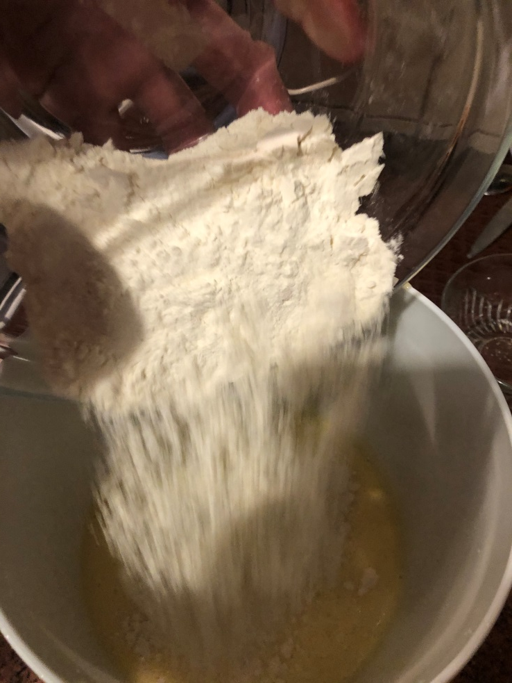
Add flour with baking powder and salt.

Slide 5
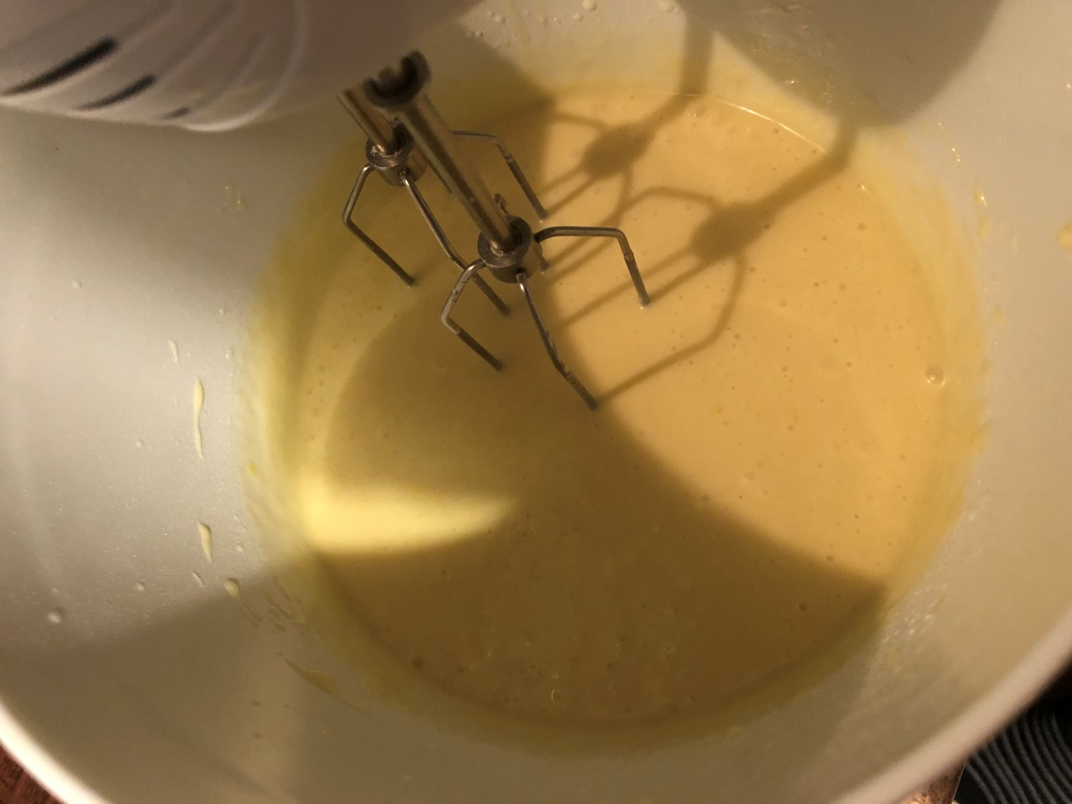
Add milk to the dough and mix until smooth. If you done OK it looks like this:

Slide 6
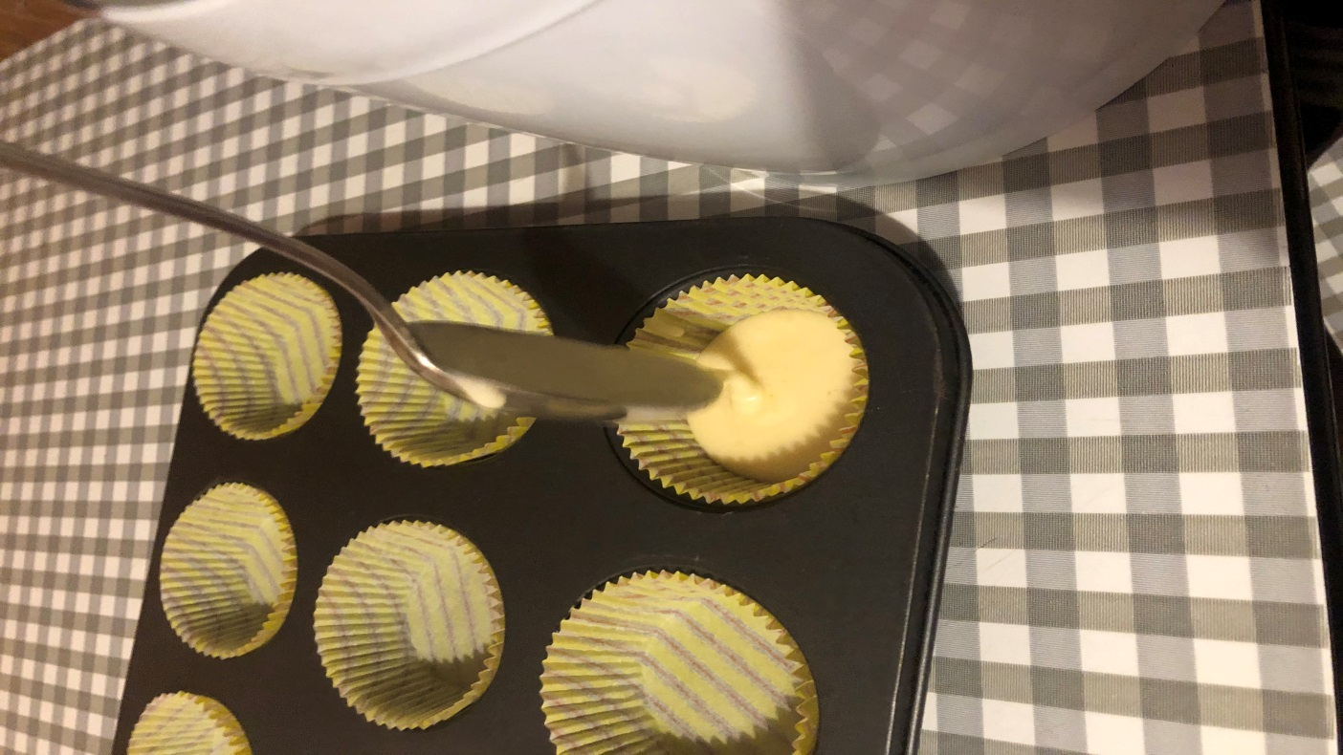
Pour the dough into greased or special paper cupcake molds: fill the dough with about 2/3 of the cup , as the cupcakes will rise during baking.

Slide 7
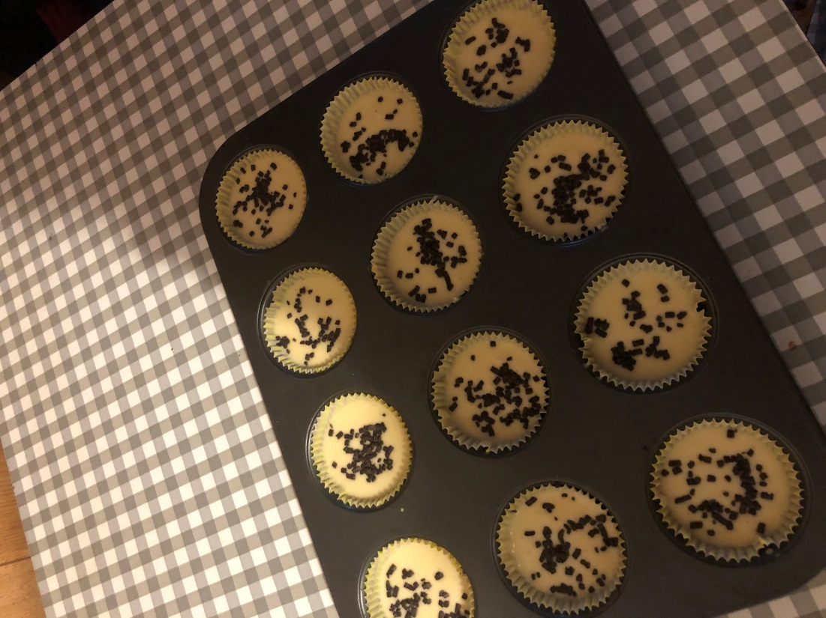
Bake in a preheated oven at 180°C for about 20 to 30 minutes. For better taste add chocolate chips.

