Slide 1
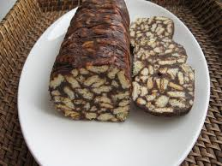
PIE “LAZY”
Recipe
Made by Ernestas

Slide 2
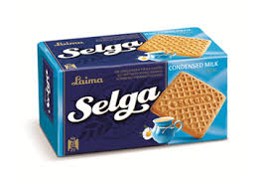
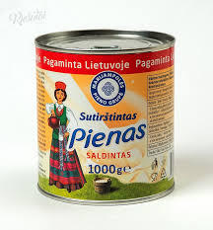
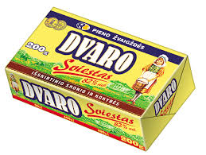
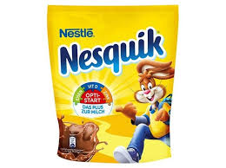
Ingredients
450 g biscuits ,,SELGA“
1 can of sweet condensed milk
200 g butter
5 tbs. cocoa

Slide 3
Making
Crush cookies in a bowl in small pieces.
Melt butter over low heat in the melted butter add condensed milk, add cocoa.
Pour the mass into the biscuits and mix everything well.
Place the dough on baking paper, shape it to the desired shape, keep at room temperature and then put in the refrigerator to cool overnight.

Slide 4
Enjoy your meal

